Slide 1

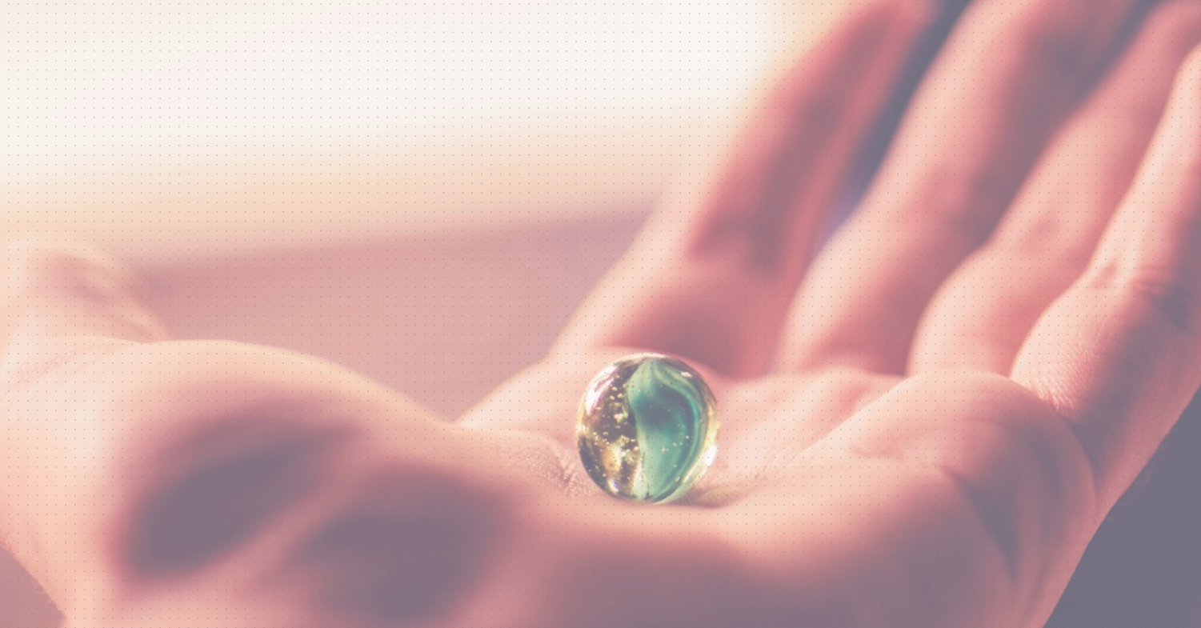
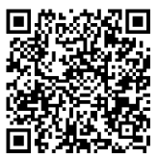
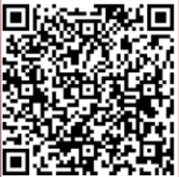
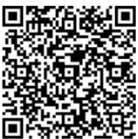
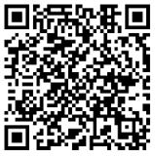


c2S With the right support
Dementia Experience
Behaviors vs Need
Melody Karick CDP, CMDCP, PCHA, PAC Dementia Consultant, Educator, Certified Cognitive Screener and Creator of C2S Dementia Experience and Education
www.theforgeworks.org mkarick@theforgeworks.org
Hold Harmless
Pre-Survey
Presentation
Notes:
Good morning. My name is _________, I am (occupation)____________.
I am here because (tell your why in a few words) ____________. My goal by the end of this session ________________.
Let's Get Started:

Slide 2
Getting Started
Sign In / Pre-Survey Completed
C2S Dementia Experience Kit
Please take care of your needs
  Drink/Stand Up/ Restroom/ Other
Notes:
Please take a minute to make sure you signed in and complete the pre-survey. You will need to complete Sign In/Out, Pre/Post Survey to get credit for the class. Also, if you did not pick up C2S Dementia Experience Kit, please do so now.
Hold Harmless must be completed to participate in the Dementia Experience. If you do not want to immerse yourself in the experience, you may participate as an observer.
You may download the presentation using the QR Code provided.
Please take care of your personal needs as they arise.
As the class goes by, you will hopefully have a few “aha” moments.
Think about your learning style, how you retain and remember. A healthy brain can remember 5-8 things. In this time together, I will be giving you information on a lot more than 5-8 things.
Whatever means to bring things learned to your memory, please feel free to do so.

Slide 3
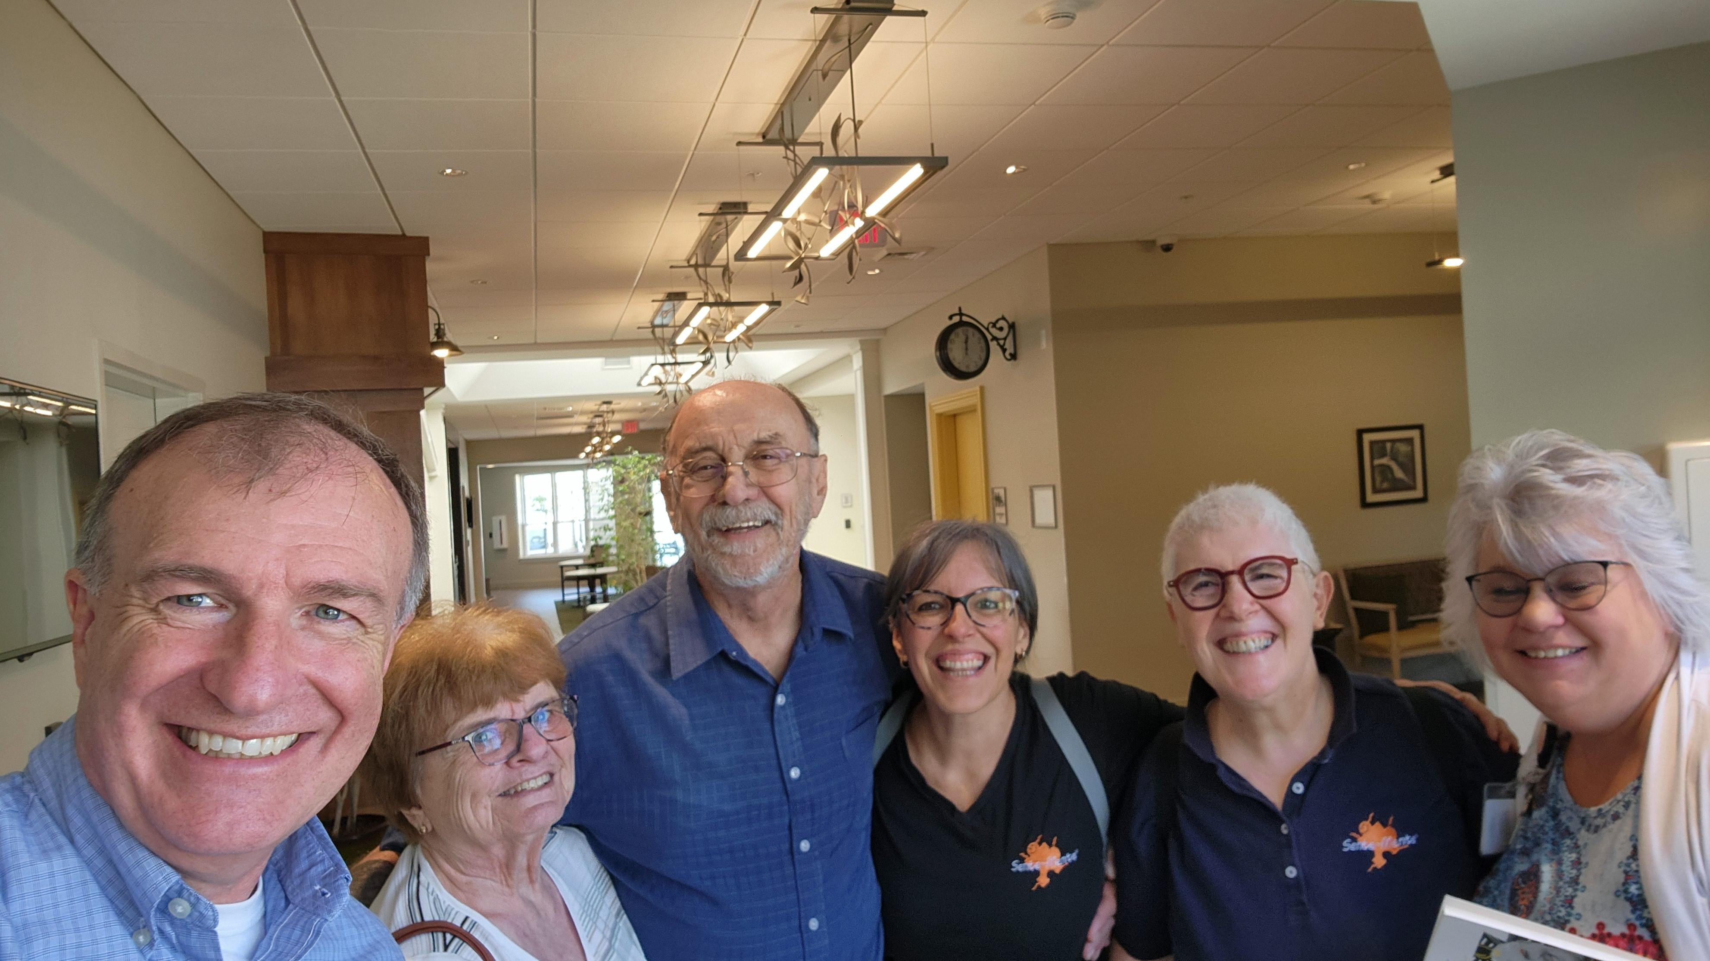
Dementia Experience: Behavior Vs Need
Agenda
Dementia Experience
Behavior Vs Need
Notes:
Our objectives today:
Read screen.
Let’s get started.

Slide 4
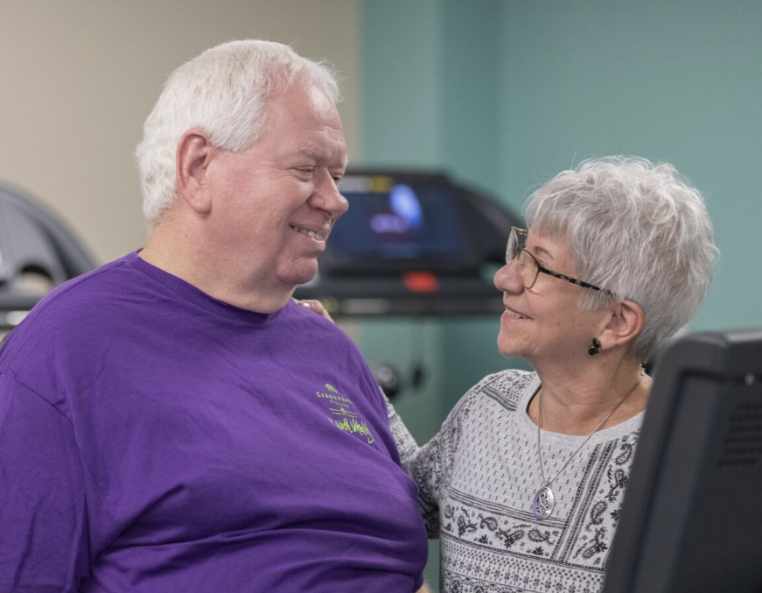
Dementia Experience
Middle to late stage
Notes:
Make sure everyone has an Experience Bag.
Make sure all completed QR Code. Collect the completed Hold Harmless forms if paper.
Read General Instructions. Look at the paper. Do not make eye contact with participants.

Slide 5
Walk in the shoes of PLWD (Part 1)
Discuss the Experience
Walk in the shoes of PLWD (Part 2)
Discuss the Experience
Walk a mile in my shoes…
See what I see,
Hear what I hear,
Feel what I feel…
Then maybe you’ll understand
Why I do what I do…
Till then don’t judge me.
~Unknown Author
Notes:
Read 4 bullet points on slide
Read the poem from an unknown author
You will remain on this slide until after you complete your second Dementia Experience Debrief
General Instructions
Get out General Instruction paper
Read General Instructions to the group
Start Garbing right after General Instructions are read
Garbing
Open Bag
Turn Headphones On
(Instructions together) If at any point headphones turn off, raise your hand. I will assist you.
Put Headphones On Table Until Last Step
Take Shoes Off
Leave Shoe Inserts in Plastic Cover
Put Shoe Inserts with Plastic Cover in Your Shoe
POINTED SIDE UP
Put Shoe Back On
MAKE SURE SHOELACES ARE TIED
Take Off Your Glasses
Put On Goggles
Put On Gloves
Put Headphones On Head
Look Up At Instructor
Wait for next instruction
Lights
If garbing in the experience room – turn off lights to the predetermined setting. Room should be low light
Motion for them all to come to you
Read the Objectives list.
Do not make eye contact – look at your list the whole time
Read in normal voice
Do not give any visual cues
When done reading list say “Your time begins now” and walk away
Do “work”
Answer emails on your phone
Tidy the room
Get a drink or eat a snack
If there are more than one instructor, have a conversation
If someone approaches you, say “you’re ok” and walk away
After a few minutes, tell a few people who are doing nothing or getting frustrated, “you’re doing good… keep going”
Always stay in the room with them
After 8 minutes motion for them to take their headphones off
Debrief 1:
One word, how did you feel? (Everyone respond)
One sentence, why do you think you felt that way?
What would have helped?
Why do you think that would have helped?
Experience #2:
Everyone put their headphones back on. Make sure everything is exactly the same EXCEPT YOU 😊
Using C2S Approach and Techniques.
Have them complete 1 of the original tasks.
Have them complete the task.
Have them show you what they did when they are done. If someone else is helping you, have them show them what they completed and have them do the following next steps. All must complete task as asked. If not, have helper support them but don’t do the task for them and don’t let them off if the task is not right.
Give them a thumbs up and motion for them to take their headphones off when they complete the task.
Do not make them wait.
Tell them quietly to remove all components, sanitize them and put them back in the bag.
We will debrief when everyone is through.
Please do not discuss anything until it is time for us all to debrief.
Continue to second person and so on.
Make sure you keep track of each person you gave a task to.
Continue until everyone is through.
If someone gets stuck on a task, use C2S training to support them.
Do not do the task for them.
Do it with them.

Slide 6
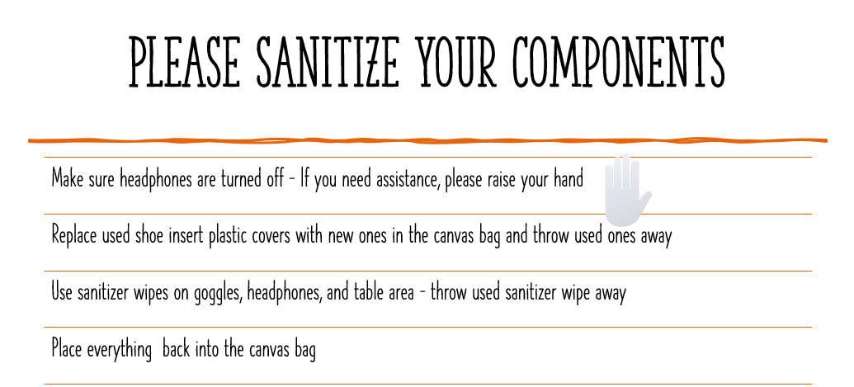

Notes:
Sanitize Components and sit quietly until all are through the 2nd Experience.
Start Debrief 2 while they are finishing sanitizing.
Debrief 2:
One word, how did you feel? (Everyone responds)
One sentence, why do you think you felt that way?
What helped?
Why do you think that helped?

Slide 7
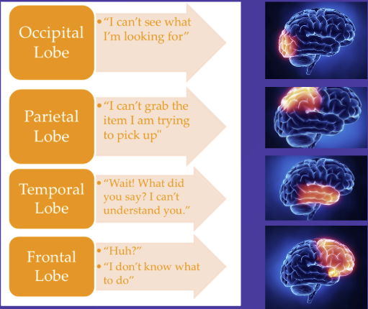
How did the experience affect your brain
Notes:
Did you think...
I can't see what I'm looking for. This would be your occipital lobe.
Pause...
• How about...
I can't grab the item I'm trying to pick up. That would have been your parietal lobe.
Pause...
• What about...
What did you say? I didn't understand you. That would be your temporal lobe.
Pause...
• Or,
I don't know what to do. That would be your frontal lobe.
Pause...
• Although we know that everyone's experience with dementia is different, we also know that each area of the brain is affected differently.
o Knowing this, how can we use this information to better serve people living with dementia?
Pause...
• Could we notice where they are struggling, and support that area better?

Slide 8
Components
Goggles
Shoe Inserts
Headphones
Gloves
Notes:
Shoe inserts:
Simulate pain.
It doesn't have to be in the feet.
It could be arthritis, back pain, sore throat, shirt too tight, tag scratching the back of my neck, or any other pain or discomfort.
Goggles:
Vision limits.
We talked about this in great detail when we learned about how dementia affects the brain.
Headphones:
Sound complexity.
What we hear influences how we feel and how well we understand the world around us. We have experienced this firsthand when a collage of familiar sounds quickly becomes overwhelming.
ForgeWorks partnered with Composure, an audio technology company on a mission to serve human health and wellbeing through sound, to create this unique audio experience.
In addition to this audio experience, Composure is also the creators of Sound Blanket™ - an evidence-based, non-pharmacological intervention that uses sound to improve sleep quality for residents in memory care and assisted living environments.
Gloves:
We lose our abilities in our skill fingers (first 3 fingers), but we keep our strength (last 2 fingers).
(Demonstrate Hand Support: Strength and Skill) We will learn more about hand support in a little.
Imagine buttoning your buttons, putting on your earrings, cleaning your glasses, tying your shoes...
Do you think this would be easy or hard with loss of skill fingers?

Slide 9
Normal dementia Behaviors…
Did you experience them?
What are other dementia behaviors that you see?
  Wandering
  Agitation
  Confusion
  Loneliness
  Inability to process information
  Combative
  Resistant to help or care
  Hoarding
  Self Isolating
  Not aware of surroundings/safety
Notes:
What are some "Normal Dementia Behaviors” that you experienced during the Dementia Experience?
Pause...
Wandering? Agitation? Confusion? Lonely? Inability to process information?
Pause...
What are other "Normal Dementia Behaviors" that you see?
Pause...
Combative? Resistant to help or care?
Have any of you experienced any “Normal Dementia Behaviors” during the Dementia Experience?
If you had any “Observers,” have them discuss what they observed.

Slide 10

Notes:
• So, what made the difference in the 2nd experience?
The environment was the same.
Pause...
• What made you successful the second time around?
Pause...
• My approach, my communication skill, my making a personal connection BEFORE showing you the task.
What about when I said, "Good Job!"
• Was what I did time-consuming?
Pause...
• Was what I did difficult?
Pause...
• Was what I did duplicatable?
Pause...
• Did what I did make a difference for you?
YOU ARE THE DIFFERENCE!
You can't take away what is going on for them.
Yes, you can manage the environment, but you have TOTAL AND COMPLETE CONTROL of if you are going to be the difference for them.
Or
Are you too tired?
Upset about something a coworker said or did or didn't do?
Did you hear that this person was combative and now you have to take care of him/her?
Is someone else's bias going to alter your experience and support for them?
Did you previously have a not so great experience with them and now are hesitant or have an opinion about them that is negative?
Or
Are you going to try to use every ounce of training.
Make a personal connection.
Go at their pace?
Every experience or interaction with a person with dementia is NOT going to be positive, even if you did everything right.
Remember, they are allowed to have a bad day.
Use your healthy brain to forgive my actions and words because of my dying brain.
YOU ARE THE DIFFERENCE!

Slide 11
Dementia Experience
Middle to late stage
Notes:
Debrief
Experience
You all completed the Dementia Experience. Each person’s experience was unique to them. Your physical and senses were altered. You were asked to complete simple tasks and you were unable to do so on your own. You were asked to complete the Dementia Experience again. This time there was ONE difference. ME!
Reflecting
Think about how you felt during the first Experience.
How would you feel if that was your norm?
Your everyday?
Thinking
Let’s talk about your 2nd Experience.
Did I make a difference? Thumbs up or thumbs down
How much time did it take for me to make a difference?
Was I able to be the difference for more than 1 person at a time?
Acting
Think:
Are you willing to be the difference for a person living with dementia?
Are you willing to try again when you fail?
How important is it TO YOU to implement what you are learning?
How important is it TO THE PERSON WITH DEMENTIA for you to try to implement what you are learning?
Tell me one thing you are willing to implement as soon as you leave today.

Slide 12
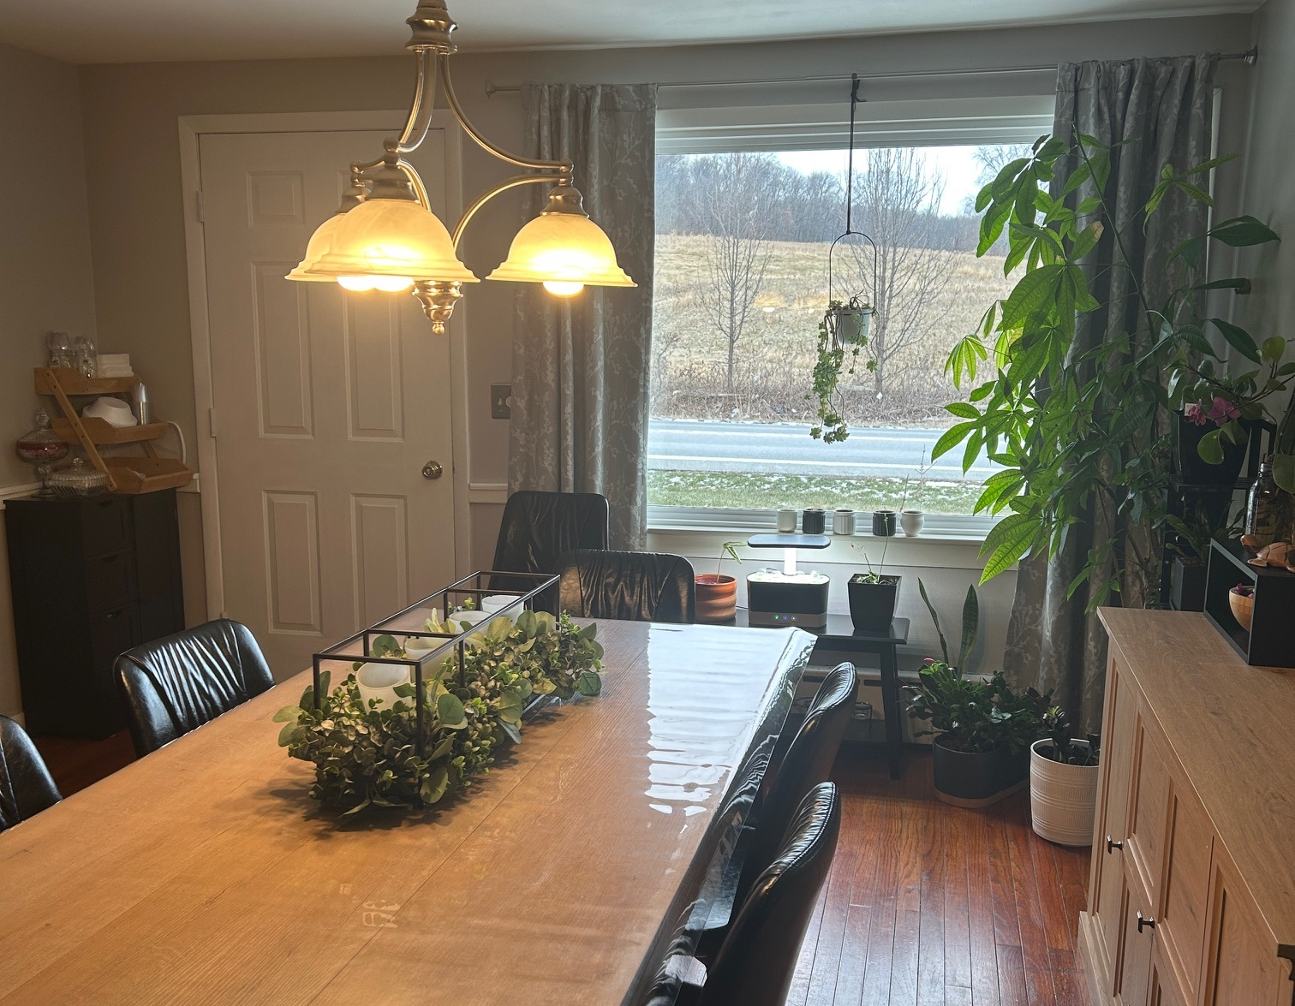
Behavior vs
Human Need

Slide 13
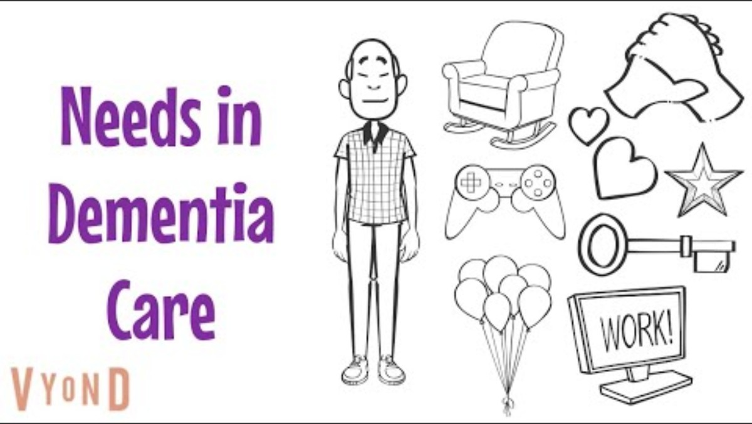
Human needs
Image you are stranded naked on a desert island with no way off. You are allowed to bring 8 items with you to make your time on the island more bearable.
What 8 things would you bring?
[Ian James]. (2025, January 27). Fundamental needs in dementia - an animation from the CAIT and Newcastle Model series [Video]. Youtube. https://www.youtube.com/watch?v=R0C2ug7AbTY
Notes:
Image you are stranded naked on a desert island with no way off. You are allowed to bring 8 items with you to make your time on the island more bearable. What 8 items would you take. Write them down.
After the video
What categories did your needs fall under?
Have you ever compared your patients staying in the hospital as being stranded naked on a desert island?
Who has human needs?
Everyone.
Those with normal healthy brains and those living with dementia.
We all have human needs.
It does not matter the age we are, or the stage of life we are living.
We all have human needs.

Slide 14
Human needs: Physical and psychological
  Physical Need:
    Hydration, Nourishment, Medication, Movement, Restroom
  Comfort Need:
    Environment – Familiar, Functional, Friendly, Safe, Included, Too Hot/Too Cold
  Identity Need:
    Role, Purpose
  Belonging and Love Needs:
    Friends, Intimate Relationships, Appreciated
  Pain Free:
    Emotional, Spiritual, Physical
Notes:
Most have heard of Maslow’s Hierarchy of Needs
Theory of motivation that suggests that human needs are organized into 5 levels
Can be divided into deficiency needs and growth needs
The Oxford Academy created the Psychological Needs for Persons Living with Dementia.
The Five Human Needs we are going to discuss is a combination of both.
Physical Need
Food, Water, Medication, Movement
Movement will look different depending on their ability
Keep movement in mind as they still have the ability.
Having them sit all the time when they can still walk is detrimental.
Comfort Need
Environment is so important.
Is the environment friendly, forgiving, functional and familiar?
Is it safe, inclusive?
Do they feel like they belong there?
Are they able to drop or spill something, dip their sandwich in water, come out to the main area not dressed?
Their coming out not dressed does not take away their dignity. It’s the reactions that we show, as well as how we pass that information along that does. And does that information really need passed on?
Identity Need
Do they have a role?
Do they have a purpose?
Think of the “identities” dementia took from them. Were they a spouse, were they a parent, were they a business owner? Did they volunteer, did they teach in Sunday School, did they travel?
Belonging and Love Need:
Do friends and family visit or involved?
Do they have intimate relationships?
Do they feel appreciated?
Pain Free:
Physical pain can be detected by watching their body language, their facial expressions, their moan or sigh.
Physical pain can be noted by looking at their medical chart. Do they have a history of something that may be causing physical pain? Do they have arthritis, previous back surgery, or a history of headaches?
We often think of physical pain but forget spiritual and emotional pain.
Did I read devotions each day?
Am I used to having my spouse or children with me? (Even if they are grown or passed, do I think that I am at an age that they would still need me or that they would be with me all the time?)

Slide 15

Communication of needs
Their Actions Signal Their Need
  Body Language:
    Pacing, Boredom, Anxiety, Confusion
  Vocalization:
    Moaning, Yelling, Distressed
  Aggression or Agitation:
    Verbal Outburst, Visibly Frustrated, Misunderstood
  Repetitiveness:
    Anxious, Bored, Misunderstood, Lonely
  Changes:
    Appetite, Sleep Pattern, Personality, Self Isolating
Notes:
Communication of human needs are often mistaken or have an added stigma as “behavior.”
Something negative that they can help.
The thought of a “behavior” often has a “punishment” that goes with it.
Unconsciously, is that what we are doing to people living with dementia that are exhibiting a “behavior”?
Are they the first ones you invite or include in an outing or something fun?
What if we took the word, the thought, it’s a behavior out of our care that we provide.
What if we instead looked as what is being communicated as a great big neon sign that says, “I HAVE A NEED.”
How do you communicate your needs other than using words?
Does your body language communicate your needs?
What am I telling you if I am pacing?
What about vocalization without words?
Moaning?
Yelling?
Or how about with swear words?
Have you ever been so mad that someone might label you as aggressive?
Have you ever been so passionate about something that you might be labelled as well?
Have you ever repeated yourself more than once? Why?
Were you trying to get your point across?
Might you not felt comfortable so you stuck with what you knew?
Have you ever repeated words out loud to comfort yourself?
“You Got This,” “I’m OK,” “Keys, Keys, Keys” when you are looking for them?
Have you ever been so sad you were not hungry? Or so anxious that you just kept snacking?
Guess what…
If you just said Yes to any one of the above, you were communicating a need just like people living with dementia.
Their actions can signal their needs just like your actions signal your needs.
Be a Detective: Magnifying Glass
Why is it as soon as someone shows signs of dementia, now all of a sudden, they are behaviors?
What if we put away our judge’s gavel and stopped judging them and we pulled out our detective’s hat and magnifying glass and wondered what they needed or are trying to communicate?
What form of communication are they exhibiting?
What is going on around them?

Slide 16
Anticipation Techniques
Behavioral Triggers:
Confusion
Pain/Discomfort
Change
Overwhelming Environment
    Environment
    Amygdala Level
    Routine
    Eliminate Boredom
    Burn Energy Throughout the Day
    Lighting
    Routine Generation of Positive Feelings/Reassurance
    5 Senses
    Unmet Needs
    They Can Still Have a Bad Day
Notes:
Did you do anything to anticipate your needs today?
Bring a sweater?
Bring a drink?
Bring a snack?
Bring a pen?
What if we started to anticipate their needs?
Before you leave their room, take a minute to think about what needs they might have.
Make sure they have a drink available, their comfy blanket, something to hold to keep them company, something visibly out for them to do that they enjoy…
Do you think that if we anticipate their needs like we do for ourselves, that they may have fewer negative communications of needs? Maybe less falls?
Be a Detective: Magnifying Glass
Get into a small group and discuss what are some needs that may be taken care of if we use anticipation techniques? (Give them a few minutes)
What are some that your group came up with?
Do you think it takes more time to anticipate a need or respond to them communicating a need?
Definitely more time to respond.
Get back into your small group and discuss what are some techniques you are going to try? (Give them a few minutes)
What did you come up with?

Slide 17
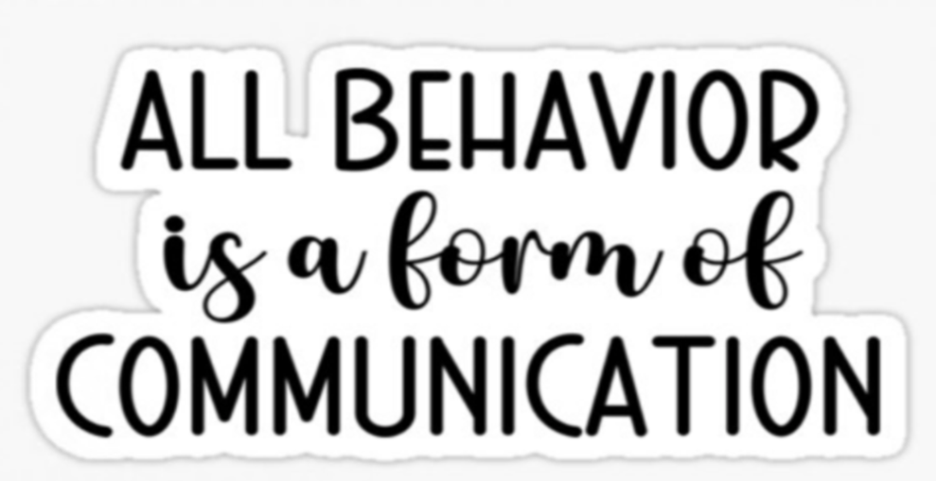
Notes:
All behavior is a form of communication.
What am I communicating to you right now?
(Roll my eyes and cross my arms at my chest)
How about now?
(Put my finger at my mouth as to silence them)
What about now?
(Look angry and wave your fist)
How many words did I use?
Did you understand what I was “Communicating” to you?
Then why do we call what I did communication and when a person living with dementia does something it’s a behavior?
It all goes back to your mindset!

Slide 18
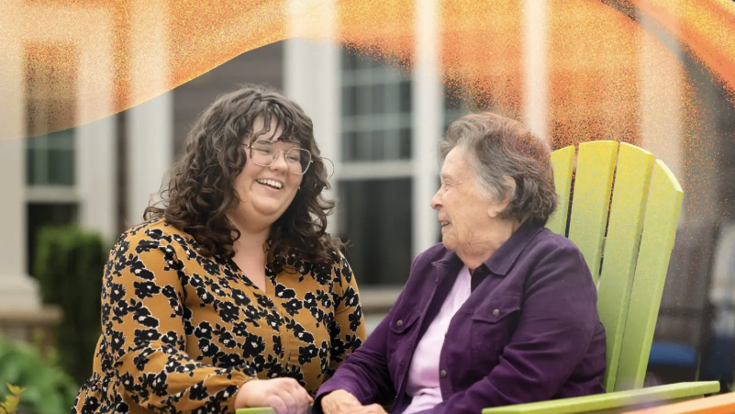
Skill building
Notes:
2 HR Skill Building Session you will learn the skills used during the 2nd Dementia Experience.

Slide 19
Behavior vs
Human Need
Debrief
Notes:
Debrief
Experience
We discussed the difference between a behavior and a human need as well as how we can anticipate human needs so they do not resemble a “behavior”.
Reflecting
Think about what human needs you may have labelled a “behavior”.
How would a mindset shift from behavior to need reflect on the people you are supporting? How would it reflect on your shift?
Thinking
Let’s talk about that.
Do you think it will make a difference? Thumbs up or thumbs down
Acting
Think:
Are you willing to be the difference for a person living with dementia?
Are you willing to try again when you fail?
How important is it TO YOU to implement what you are learning?
How important is it TO THE PERSON WITH DEMENTIA for you to try to implement what you are learning?
Tell me one thing you are willing to implement as soon as you leave today.

Slide 20
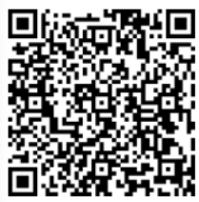
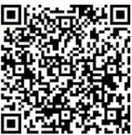
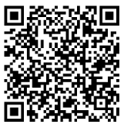
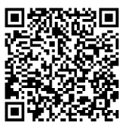
Thank you
For More Information
Melody Karick
CDP, CMDCP, PCHA, PAC
Dementia Consultant, Educator, Certified Cognitive Screener, Creator of C2S Dementia Experience and Education
Please Sign Out
Certificate
Post Survey
Must Complete Sign In, Sign Out, Pre Survey, Post Survey, AND Certificate
Notes:
Thank You for spending time with me today.
Please remember:
New knowledge means NOTHING unless YOU implement it.
You must be committed and practice. You will not master a new skill without practicing.
Please complete QR Codes for signing out, certificate and post survey.

