Slide 1
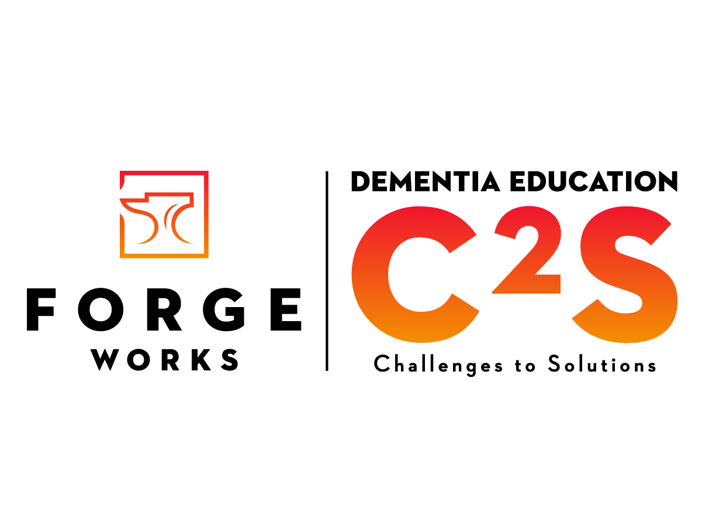

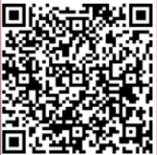
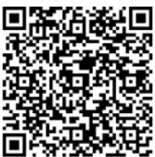
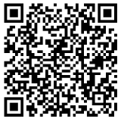


c2S With the right support Beyond Dementia Diagnosis: Shifting Perspective on Brain Change Agenda
Melody Karick CDP, CMDCP, PCHA, PAC Dementia Consultant, Educator, Certified Cognitive Screener and Creator of C2S Dementia Experience and Education
www.theforgeworks.org mkarick@theforgeworks.org
Pre-Survey
Presentation
Notes:
Good morning. My name is _________, I am (occupation)____________.
I am here because (tell your why in a few words) ____________. My goal by the end of this session ________________.
Let's Get Started:

Slide 2
Getting Started
Sign In / Pre-Survey Completed
2 Resonate Cards
Please take care of your needs
Drink/Stand Up/ Restroom/ Other
Notes:
Please take a minute to make sure you signed in and complete the pre-survey. You will need to complete Sign In/Out, Pre/Post Survey to get credit for the class. Also, if you did not pick 2 My Resonation Card, please do so now.
You may download the presentation using the QR Code provided.
Please take care of your personal needs as they arise.
As the class goes by, you will hopefully have a few “aha” moments.
Think about your learning style, how you retain and remember. A healthy brain can remember 5-8 things. In this time together, I will be giving you information on a lot more than 5-8 things.
Whatever means to bring things learned to your memory, please feel free to do so.

Slide 3
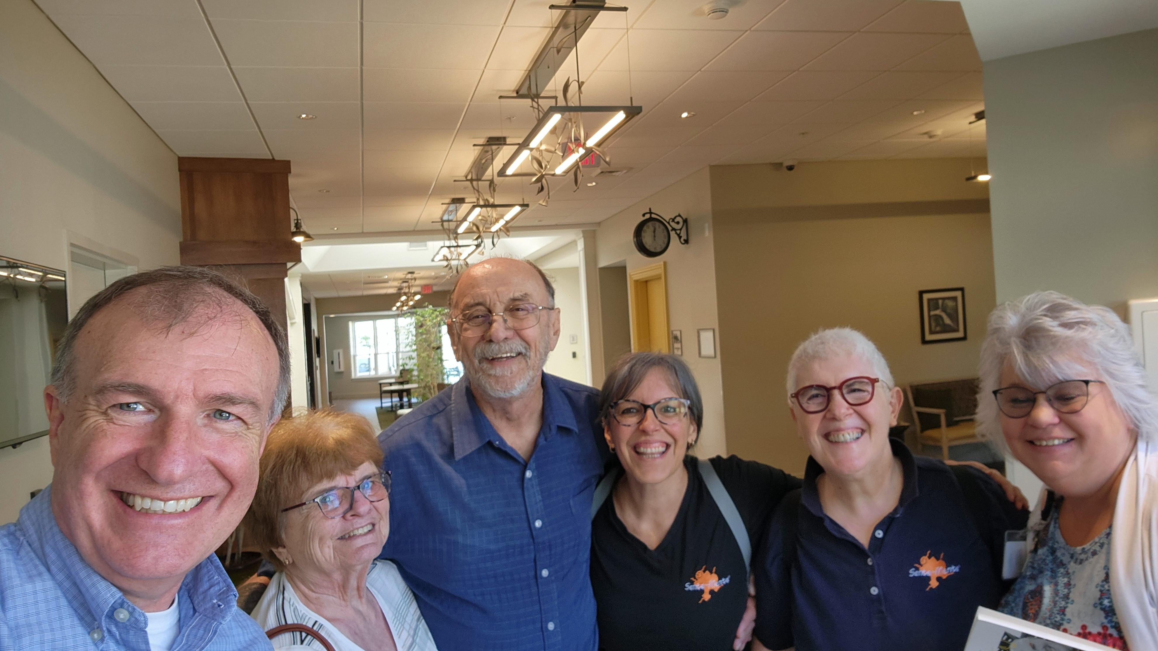
Beyond Dementia Diagnosis: Shifting Perspective on Brain Change Agenda
Mindset
What is Dementia
How Does Dementia Affect the Brain
Notes:
Our objectives today:
Read screen.
Let's start with Mindset.

Slide 4

Mindset

Slide 5

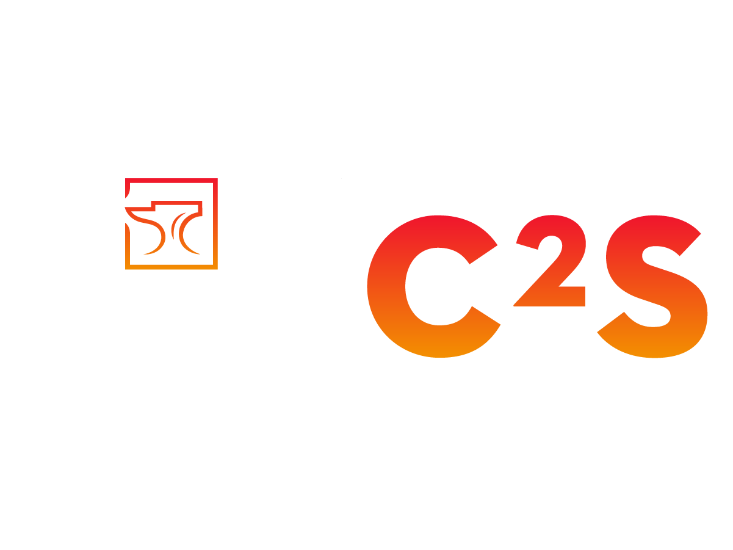

What is Your reaction or how do you feel when you hear the word dementia?
Notes:
What is your reaction or how do you feel when you hear the word dementia?
o Ask for responses and reflect on each one
• Were the responses positive or negative?

Slide 6
Mindset “the problem is not the problem the problem is your attitude about the problem” ~ captain Jack Sparrow
Fixed Growth
Dislikes Criticism Welcomes Criticism
Avoids Change Embrace Change
Prefer Comfort Zone Step out of Comfort
Struggles with Failure Learns from Failure
Threatened by Other’s Learn from Other’s
Focus on Proving Self Values the Process
Notes:
"The problem is not the problem. The problem is your attitude about the problem." Captain Jack Sparrow
Before we look into each mindset, would you say you have a fixed mindset or a growth mindset?
Have them raise their hand for which they are.
Read down the lists.
Do you have some attributes of both?
Did you have more of one than you thought you would?
Does your mindset affect others?
o According to Stanford Report, “Yes, your mindset significantly affects others around you, as your attitude, outlook, and behavior, which are all shaped by your mindset, directly influence how you interact with and impact people in your life; a positive mindset can create a positive atmosphere, while a negative one can have the opposite effect.”
• People living with dementia may not always understand your words, but they do understand how you make them feel.

Slide 7
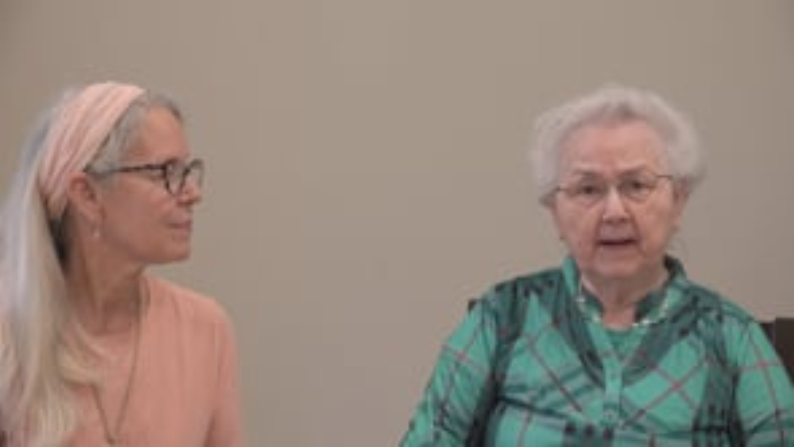

Slide 8
Mindset Debrief
Notes:
Debrief
• Experience
This section was about getting started, about preparing ourselves, our mind included as well as thinking about communication.
• Reflecting
What is your mindset right now?
Are you ready to learn or are you thinking about being on the floor, or a conversation you had earlier, or something you are doing tonight?
Are you invested in making some changes to how you and others care for people living with dementia?
• Thinking
I am going to show you some things that you know and hopefully some things you do not know today.
It’s going to be up to you with how you receive the information, your mindset, and if and how much you implement what you learn.
• Acting
Think:
Are you willing to be the difference for a person living with dementia?
Are you willing to try again when you fail?
How important is it TO YOU to implement what you are learning?

Slide 9
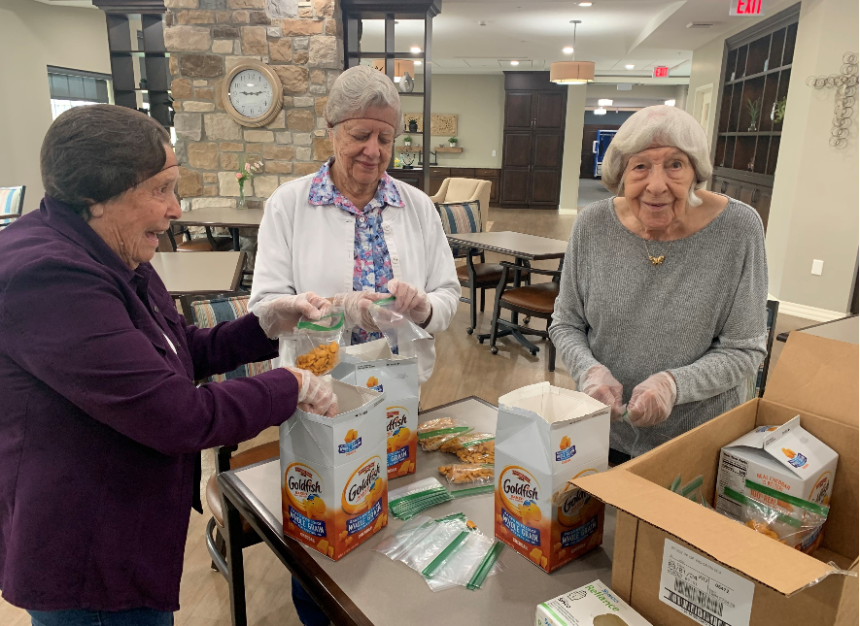
What Is Dementia

Slide 10
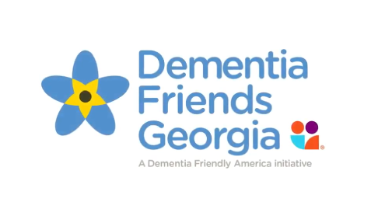

Early-Stage Dementia
5 Key Messages
It is NOT a part of normal aging
Dementia is caused by diseases of the brain
Dementia is not just about having memory problems
It is possible to have a good quality of life living with dementia
There is more to the person than dementia
Notes:
Dementia Friends
• National Program Dementia Friends breaks down to State (Dementia Friends PA) and some have in your local county/community (Dementia Friendly Lancaster County).
They can be a great resource
• Video is from Dementia Friends Georgia
Meet several people in early/mid stage of their dementia journey and their loved one.
Play Video –
• Discussion After Video
How many different types of dementia did you hear discussed? (Alzheimer’s x2, Mild Cognitive Impairment, Lewy Body, Frontotemporal Dementia)
Did they all have the same symptoms? (No, each one looked very different)
Did they all discuss how horrible it is? (No, they talked about things they could still do)
Tell me about the “mindset” that you hear?
5 Key Messages
Dementia is NOT a part of normal aging.
Getting older is a risk factor, but it is not a part of normal aging.
There are children that have dementia. (Sanfilippo Disease is most common)
Dementia is caused by diseases of the brain
There are over 100 different types of dementia.
Dementia is not just about having memory problems
How many people in the video discussed memory problems?
Not every person with dementia has memory problems, especially in the early stages.
You may notice personality changes, challenges with finances, hallucinations, delusions and other things rather than memory.
It is possible to have a good quality of life living with dementia
Those in the video… Do you think they have a good quality of life?
Brian LeBlanc, Agnus Huston, and many others are advocates who are still living several years after their initial diagnosis who are still making a difference and living a good quality life.
There is more to a person than dementia
This is so true.

Slide 11
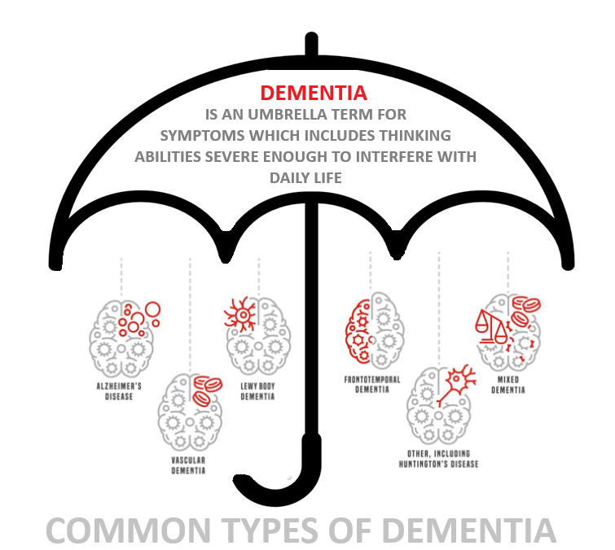
Dementia is not a diagnosis
Notes:
Dementia is not a diagnosis.
Taking a prescreening test like Mini Mental State Examination (MMSE), Mini Cog, Montreal Cognitive Assessment (MoCA), Clock drawing test, Time and Change test, Spelling “world” backwards or AD8 Dementia Screening Interview is not meant to diagnose you with “Dementia Unspecified.”
Dementia is an umbrella term.
This term is used to describe over 100 different diagnoses of brain diseases.
Replace the word “Dementia” with “Flower.”
Name me as many types of flowers as you can.
It is also used to describe their symptoms.
Some symptoms are memory loss, confusion, impaired judgment, personality changes, as well as inability to perform activities of daily living (ADL) and instrumental activities of daily living (IADL).
ADLs are the basic tasks necessary to stay healthy, safe and hygienic.
Eating, Dressing, Bathing, Walking, Toileting, Getting In and Out of a Chair.
IADLs are more complicated tasks that allow people to live independently.
Using a phone, shopping for groceries, preparing meals, managing medications, cleaning home.
Alzheimer’s Dementia
• Most common type of dementia
• Most common symptoms
Memory loss, Confusion, Vision Issues, Impaired Reasoning, as well as difficulty finding words, making plans and organizing.
• Caused by a buildup of amyloid and tau proteins in the brain that form plaques and tangles.
• Average lifespan after symptoms appears 8-20 years
Vascular Dementia
• It affects the brain’s ability to think, behave normally and remember.
• Most common symptoms
Difficulty reading and writing, loss of interest, personality changes, confusion, language problems, visual orientation problems, hallucinations, impaired motor skills. As well as difficulty planning, organizing, paying attention, making decisions, problem solving and working with calculations.
• Caused by reduced blood flow to the brain due to strokes, blood clots, ruptured blood vessels, diabetes, narrowing/hardening of the blood vessels or high blood pressure.
• Average lifespan after symptoms appears 5 years
Frontotemporal Degeneration
• Deterioration of the frontal and temporal lobes
• Most common symptoms
Unusual behaviors: compulsive or impulsive, loss of empathy and other emotions, trouble communicating through speaking, writing, and/or understanding language, ambulation, slow or stiff movements, muscle weakness and difficulty swallowing.
• Causes of FTD not fully understood. Buildup of abnormal proteins in the brain: Tau- about half FTD cases, TDP-43 in some cases and FUS in about 10% cases.
• Average lifespan after symptoms appears 7.5 years
Lewy Body Dementia
• LBD is caused by abnormal deposits of protein called alpha-synuclein, also known as Lewy Bodies. Affects the chemical in the brain.
• Most common symptoms
Visual hallucinations, cognitive changes, movement difficulties, mood problems, sleep problems, unpredictable changes in concentration, alertness and attention.
• Often confused with Alzheimer's and Parkinson’s because they share some symptoms
• One of the most misdiagnosed dementias
• ONE DOSE OF HALDOL CAN KILL A PERSON WITH LEWY BODY DEMENTIA (According to the Lewy Body Dementia Association)
• Average lifespan after symptoms appears 5-8 years
Same or Different
Which dementias discussed look the same?
Even though some may have a few similar symptoms, they are all different.
Dementia does not equal Alzheimer’s which does not always mean memory problems.

Slide 12
Most common types of dementia
 | Symptom | Neuropathology | Achieved
Alzheimer’s | Short-term memory loss Language and visuospatial skills | Amyloid plaques and neurofibrillary tangles | 8-20+ yrs
Dementia with Lewy Bodies | Visual hallucinations Fluctuation in cognition REM sleep behavior disorder Neuroleptic sensitivity | Intracellular deposits of misfolded alpha-synuclein | Generally, 5-7 yrs can range 2-20 yrs
Frontotemporal Dementia | Disinhibition, apathy, compulsive behavior (BV) Gradual language dysfunction (PPA) | Atrophy of frontal and temporal lobes Hyperphosphorylated tau protein | Generally, 7-13 yrs can vary significantly
Vascular Dementia | Impaired executive function and complex attention Symptoms vary depending on location | Large and small vessel disease Chronic progressive white matter disease Prior infarcts | Generally, 5 yrs can vary
Notes:
Differentiating Among the Most Common Types of Dementia
• This slide is a review for you to use if you are interested. It reminds us that all dementia is unique just like the person living with it.

Slide 13
Types of dementia
Alzheimer’s
Vascular Dementia
Most Preventable – Blockage in the Arteries
Lewy Body Dementia
One of the most misdiagnosed
One dose of Haldol can kill them
Frontotemporal Degeneration
Other most misdiagnosed
Parkinson’s Dementia
Overlap with Lewy Body Dementia
Mixed Dementia
Posterior Cortical Atrophy
Alcoholic Dementia
Excessive drinking which leads to deficiency in B vitamin absorption
Huntington’s Disease
Traumatic Brain Injury
Creutzfeldt-Jakob
Wenicke-Korsakoff
Pick’s Disease
Childhood Dementia –Sanfilippo
Over 100 types of childhood dementia
Over 400 Types of Dementia
Notes:
Most Common Dementia Diagnosis
• You can see some of the more common diagnosis on this slide.
• Do any of them surprise you?
• Dementia is not a respecter of age. Children can have dementia.

Slide 14
Dementia Truths
It is not a part of normal aging
It is chronic and cannot be fixed
It is progressive and will get worse
It is terminal
Early diagnosis and treatment CAN help manage symptoms
Some dementia-like symptoms may be reversible: depression, vitamin deficiencies, medication side effects, can mimic dementia and may be treatable
Notes:
There are many things we don’t know about dementia, but there are some things that we know for certain.
At least 2 parts of the brain are dying
It is chronic and cannot be fixed
It is progressive and will get worse
It is terminal
Early diagnosis and treatment CAN help manage symptoms in some cases
Some dementia-like symptoms may be reversible: depression, vitamin deficiencies, and medication side effects can mimic dementia symptoms and may be treatable
Although it is terminal and can be the primary cause of death, often you will see that as secondary cause.
We often see:
People with Alzheimer’s pass from pneumonia
People with Vascular pass from stroke
And some may pass due to complications from a fall

Slide 15
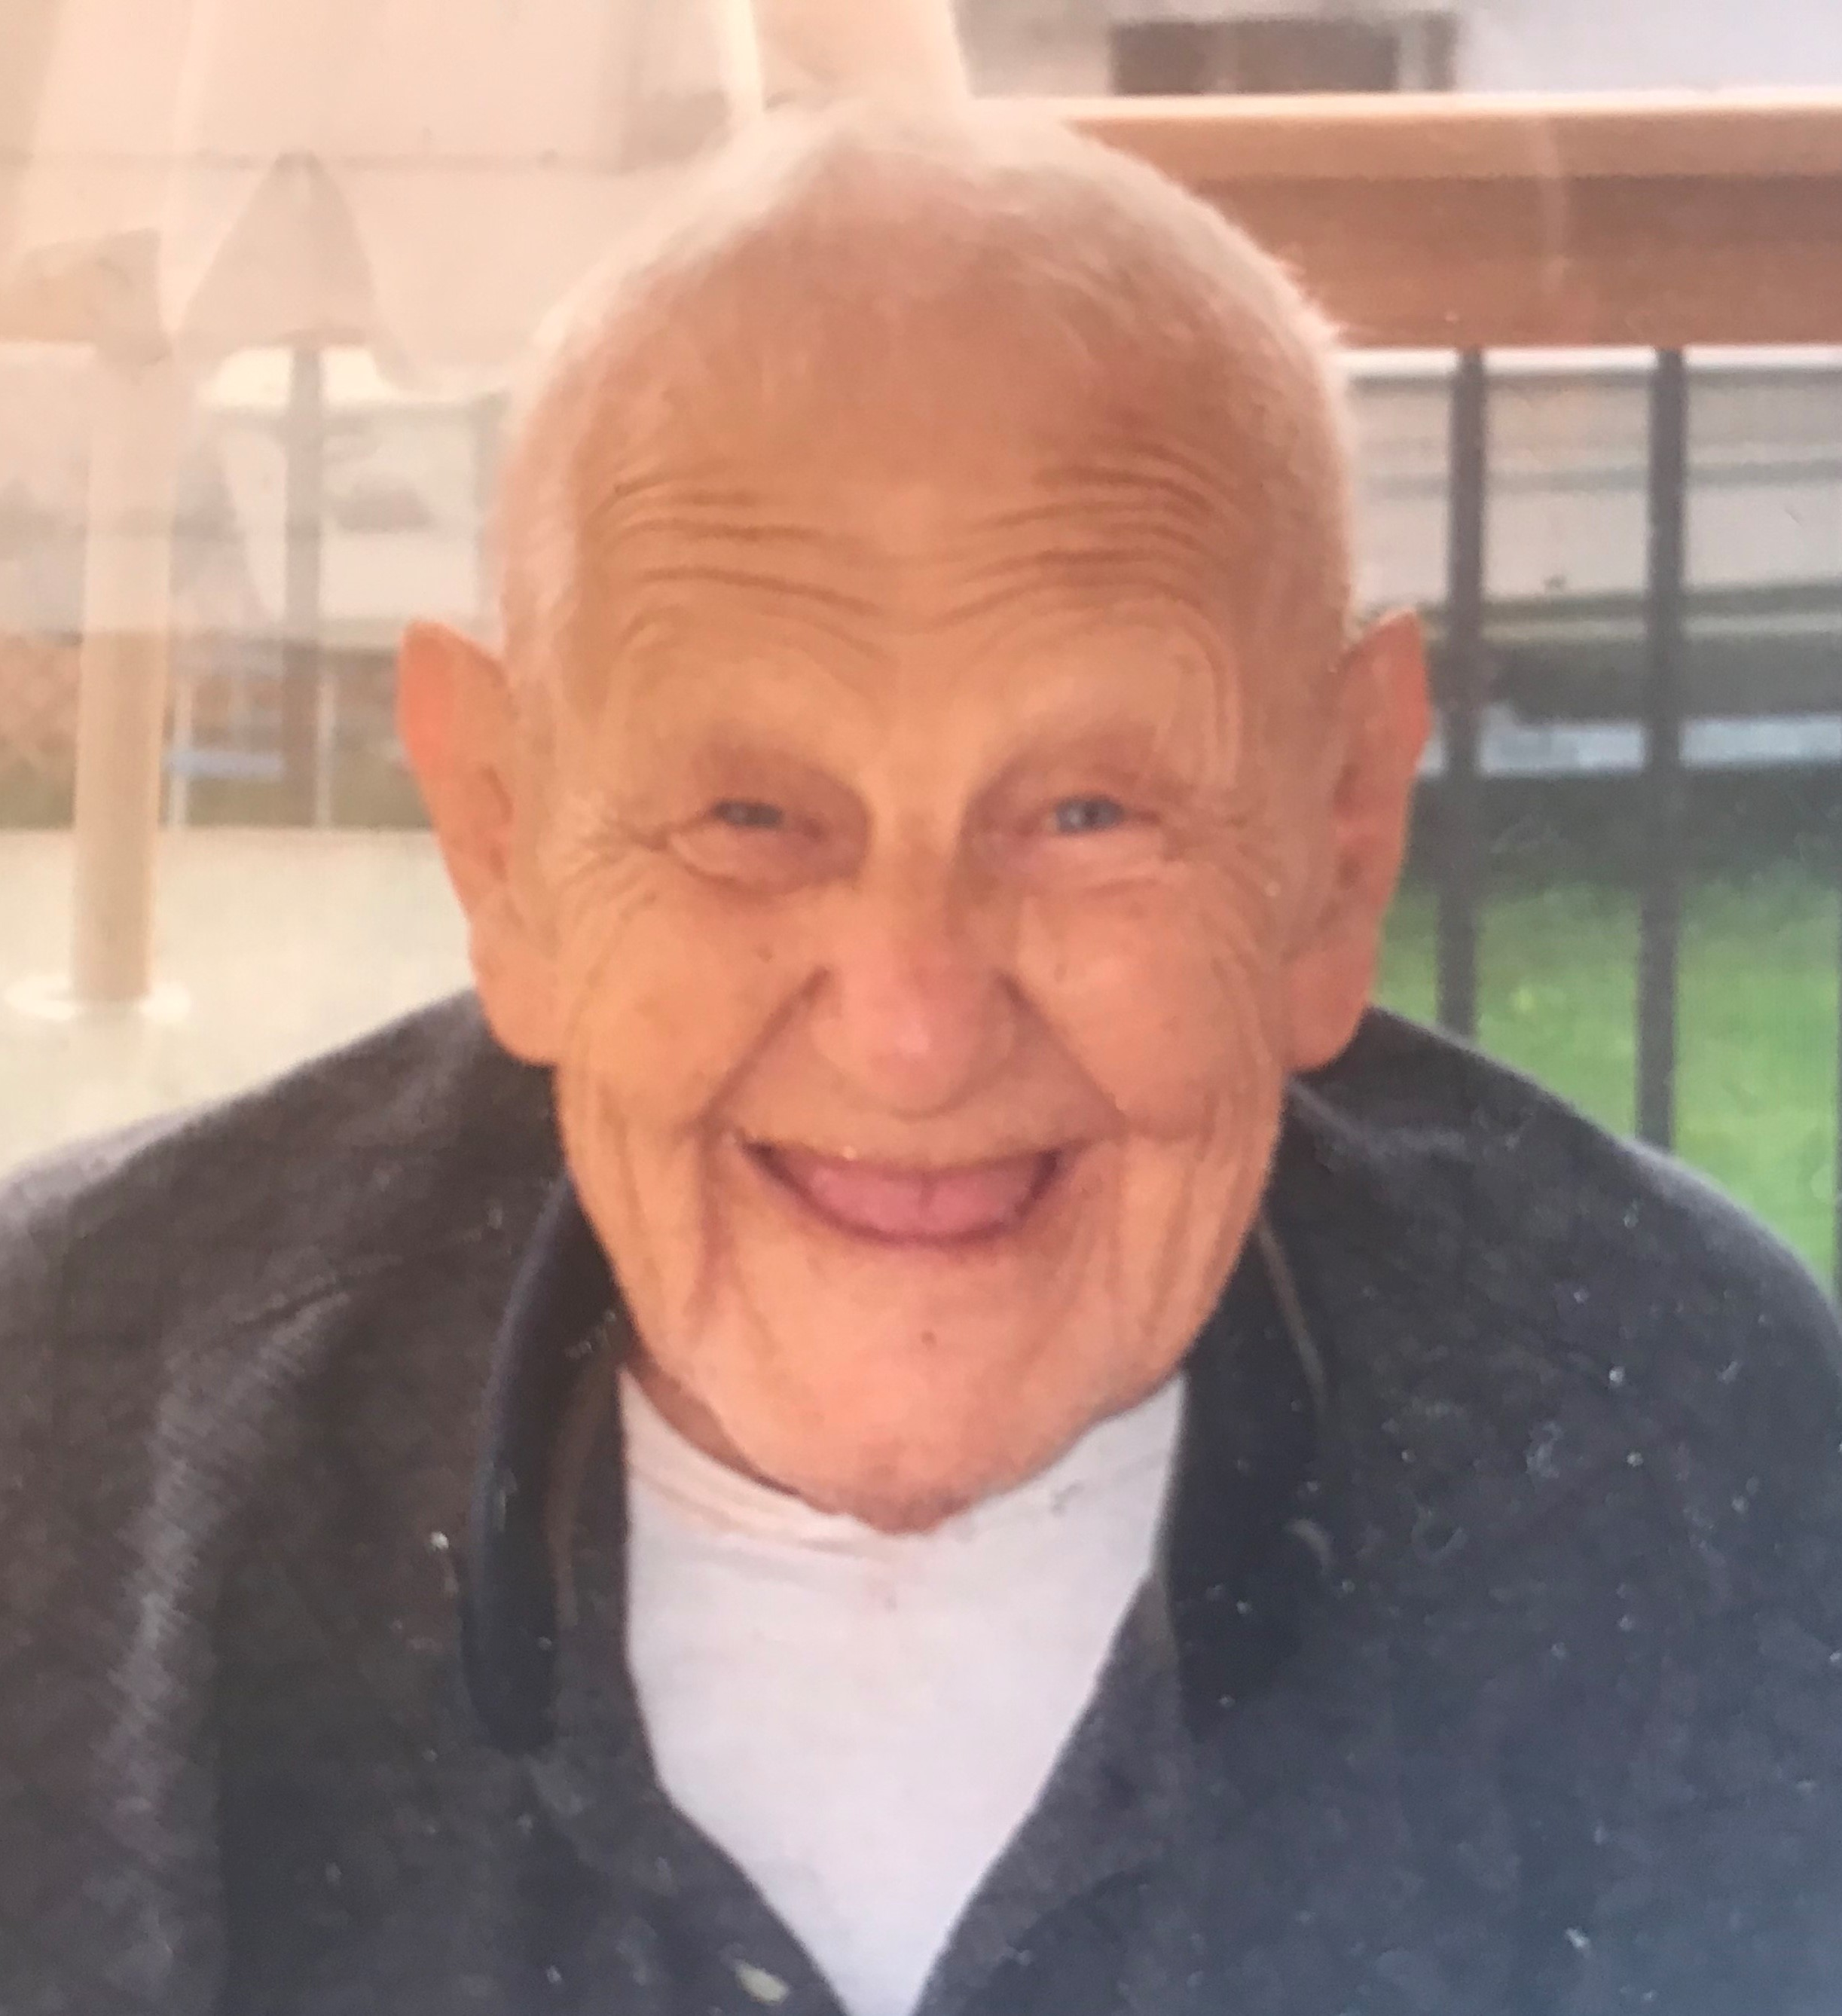
Back to Mindset
It is NOT all about loss
“Behaviors” do not come out of nowhere
It does not just affect the person living with the disease
Notes:
It stems back to the mindset:
It’s NOT all about loss
“Behaviors” do not come out of nowhere
It does not just affect the person living with the disease
How many of you have something you can no longer do? (Tell them about something you can no longer do. Some examples: Fit into a size? Do a split, Run x amount…)
Who else has something they will share they can’t do anymore?
The reason we can’t do these things has nothing to do with having dementia – a disease that is causing our brain to die. We just can’t do them.
What if you expected me to do what I just told you I can’t. What if I expected you to do what you said you couldn’t. How would that make you feel if I kept asking you to do it, with the expectation that it will be completed? How would that make you feel?
We will talk about “behaviors” later.

Slide 16
Resonate Card
Often Hot
Often Cold
Does Not Like Change
Likes Outdoor
Introvert Who Likes To Be Alone
Collector
Talks Out Loud When Thinking
DO NOT LOOK AT THE BACK OF YOUR CARD
Pick up your card and place the back hidden against your stomach
Everyone stand in a large circle with what resonates with you showing the group
Notes:
Follow instructions on screen.
Have one person start. If someone else has the same card, they can both flip them at the same time. Have them read out loud using “I am…” and whatever the card states on the front. Then have everyone else say “You…” and what the card states on the back.
Example: “I like hiking”
“You are a risky wanderer”
Have everyone take their turn.
Was what others said about you true?
How did that make you feel being labeled something you are not?

Slide 17
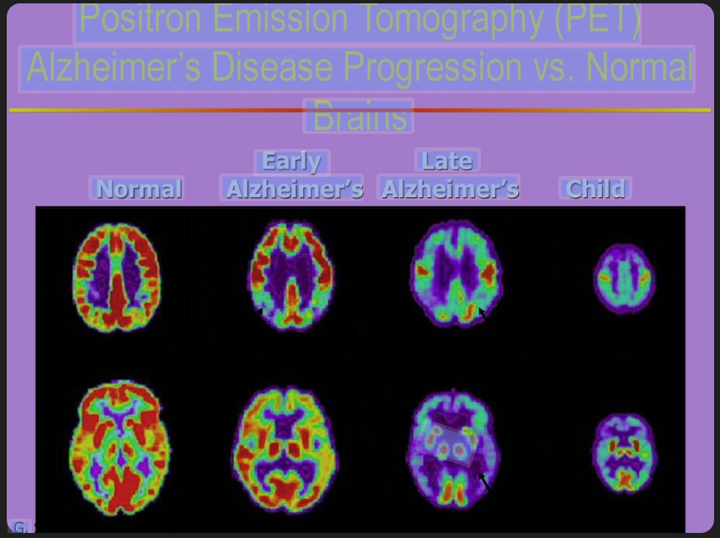
Positron Emission Tomography (PET) Alzheimer's Disease Progression vs. Normal Brains Normal Early Alzheimer's Late Alzheimer's Child 000 G.
Notes:
• Look at the normal brain.
• Now look at the person with early Alzheimer's.
What is the same?
What is the difference?
• Now let’s look at the late Alzheimer’s.
How similar or different is it to the normal brain?
• Finally, let’s look at the normal child brain.
What do you notice?
Do you see how the late Alzheimer’s looks more like an 18-month child’s brain?
• Do you think a person living with dementia can help what they are or are not able to do?
• Although their brain may resemble more like a child than an adult healthy brain, we cannot treat them like children. They have been moms, dads, business owners, employees, drove cars and so much more. We need to honor their accomplishments and honor them. One way we can do that is not treat them like a child.

Slide 18
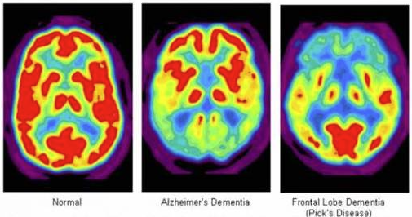
“PET/CT in Neurology: Transforming Epilepsy & Dementia Care.” Akumin, akumin.com/health/pet-ct-in-neurology/. Accessed 3 June 2025.
Notes:
Do these 3 scans look the same?
Can we treat all people living with dementia the same way?
Did the visual of the PET Scan give you any more clarity of what is going on with the brain and how it is changing for a person living with dementia?
What thoughts you would like to share regarding the scans we viewed?

Slide 19
What Is Dementia Debrief
Notes:
Debrief
• Experience
This section we learned about what the word dementia is and is not. We also saw the physical deterioration of the brain due to dementia.
• Reflecting
What is your mindset right now?
Have there been times when you were frustrated with a person living with dementia and you now realize they may have been doing the best they could?
• Thinking
Can you think of an opportunity to show understanding and maybe react differently to something a person living with dementia is or isn’t doing?
• Acting
Think:
Are you willing to be the difference for a person living with dementia?
Are you willing to try again when you fail?
How important is it TO YOU to implement what you are learning?
How important is it FOR THEM for you to implement what you are learning?

Slide 20
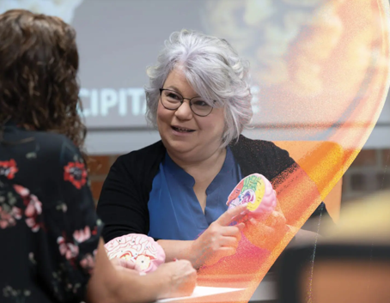
How does dementia affect the brain

Slide 21
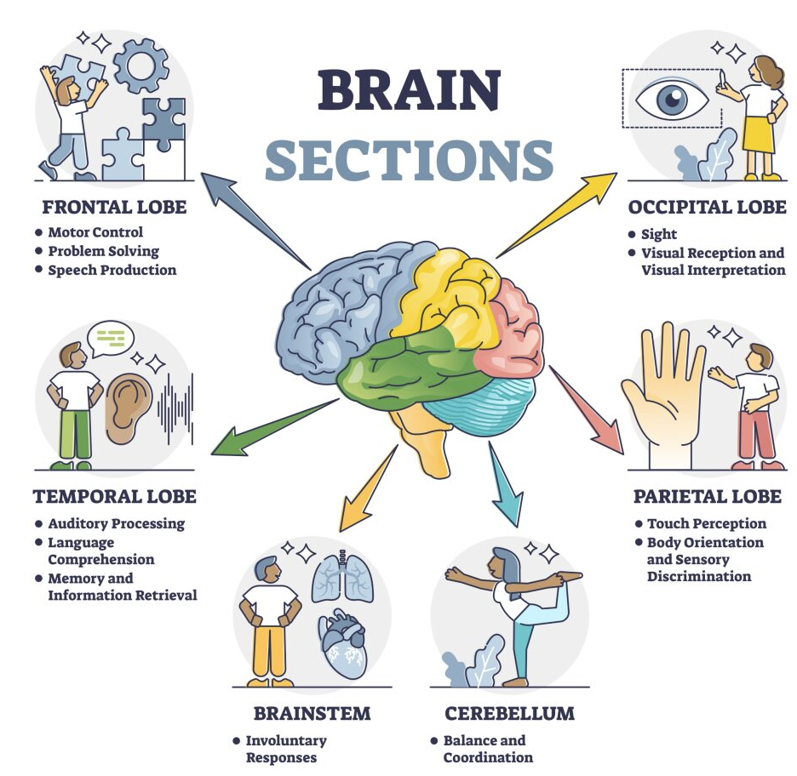
Notes:
Review the sections of the brain and its function.
Have them point to each section of the brain on themselves.
Let's go a little deeper.

Slide 22
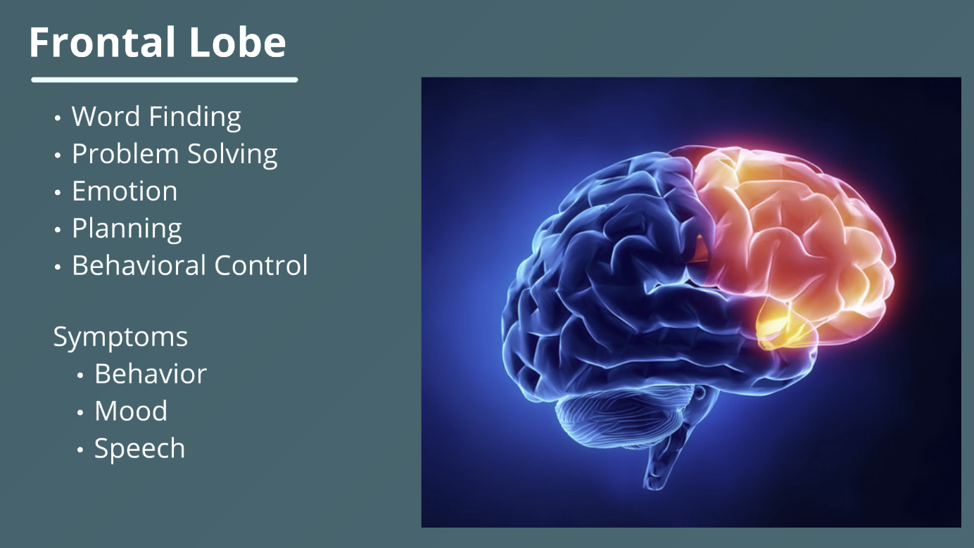
A few common conditions that affect the Frontal Lobe include:
Alzheimer’s
Expressive Aphasia
ADHD
Autism Spectrum Disorder
Frontotemporal Degeneration
Pick’s Disease
Huntington’s Disease
Lewy Body Dementia
Notes:
The Frontal Lobe
Word Finding, Problem Solving, Emotions, Planning, and Behavior are all functions of the Frontal Lobe. It is also where our Reasoning, Learning and Recall occur.
Common symptoms
Behavior
Mood
Speech
The few common conditions that affect your frontal lobe
Alzheimer’s
Expressive Aphasia (Affects how you talk, but not what you say)
ADHD
Autism Spectrum Disorder
Frontotemporal Dementia
Pick’s Disease
Huntington’s Disease
Lewy Body Dementia

Slide 23
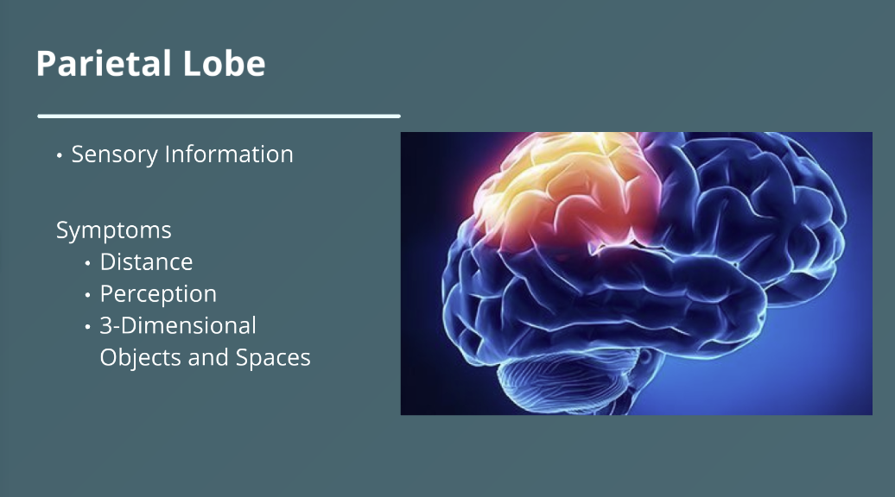
A few common conditions that affect the Parietal Lobe include:
Alzheimer’s
Lewy Body Dementia
Notes:
The Parietal Lobe
Houses your sensory information
Touch
Taste
Temperature
Pressure
Vibration
Pain
Symptoms
May involve distance, perception, 3D objects and spaces
The common conditions that affect the Parietal Lobe include:
• Alzheimer’s
• Lewy Body Dementia

Slide 24
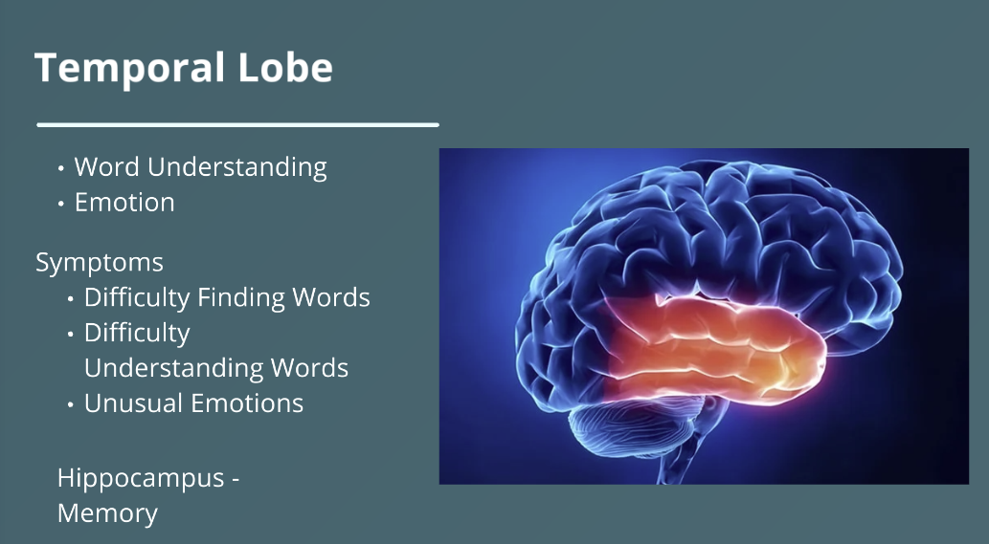
A few common conditions that affect the Temporal Lobe include:
Alzheimer’s
Frontotemporal Degeneration
Notes:
The Temporal Lobe:
Plays a key role in auditory processing, such as perceiving sounds, assigning meaning to those sounds and then remembering the sounds
Forms visual memories alongside the hippocampus and amygdala
Aids in speech production
Interprets meaning and recognized objects
Hearing and understanding speech
Controls things like appetite, thirst and hunger
Common Symptoms:
Unusual Emotions
Difficulty Finding Words
The common conditions that affect the Temporal Lobe include:
• Alzheimer’s
• FTD

Slide 25
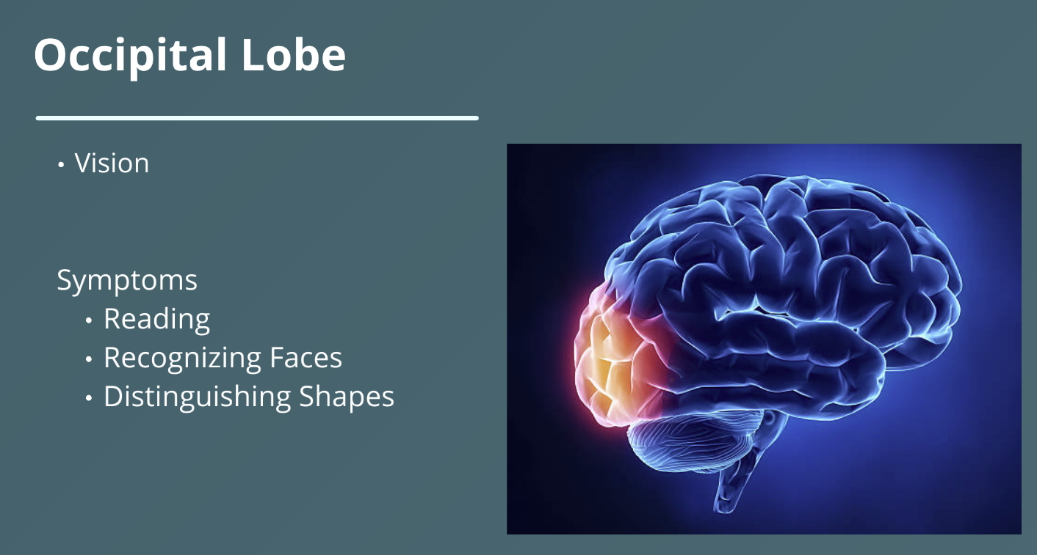
Notes:
The Occipital Lobe:
Processed Visual Information
Color, Form, Motion
Assigns Meaning
Spatial Reasoning
Size, Distance, Depth
Object and Facial Recognition
Language and Reading
Smallest of the 4 Lobes
Common Symptoms:
Visual Hallucinations
Misperception Understanding what they See
Object Recognition
Posterior Cortical Atrophy (PCA) is the primary disease that affects the occipital lobe. Alzheimer’s, Lewy Body and other dementias can also affect the occipital lobe.

Slide 26

Changes in Vision Field
Reduced Peripheral Vision
Motion is Challenging
Unable to Recognize Objects
Brain Unable to Process Information
Issues with Depth Perception
Notes:
You may notice:
Motion is Challenging
Unable to Recognize Objects
Brain Unable to Process Information
Issues with Depth Perception
Let’s look at changes in vision field.
We typically lose 1-3 degrees of peripheral vision per decade of life. By the time you reach 70s and 80s, you may have lost 20 to 30 degrees in your peripheral vision field.
Let’s use this as the field of vision without loss.

Slide 27
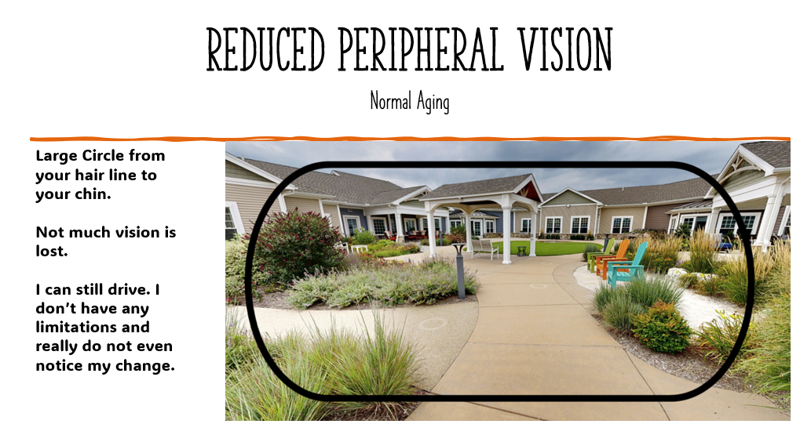
Notes:
Put your thumbs near the bottom of your face close to your chin and your pointer fingers up near the top of your head to outline your face. Make a large circle from your hair line to your chin.
Notice you did not lose that much of your line of vision.
I can still drive. I don’t have any limitations and really do not even notice my change.
Let’s use this as the field of vision as normal aging loss.

Slide 28
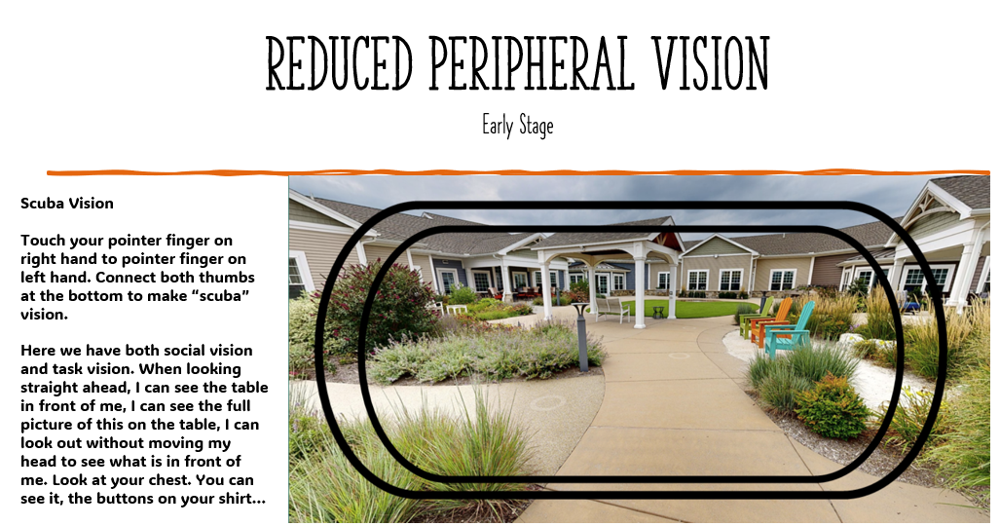
Notes:
Now let’s put your thumbs along your cheekbones across the front of your face to the bottom of your nose and your pointer fingers above your brow line making a “scuba mask.”
Now what do you notice with your vision? (Take your hands away and then put them back up to your face making a scuba mask again.)
Do you notice that you are losing peripheral vision?
Look down at your shirt, can you see your chest, your buttons?
With “Scuba Vision” you still have social vision and task vision.
Let’s use this line of vision as someone possibly living with dementia in the early- middle stage of dementia.

Slide 29
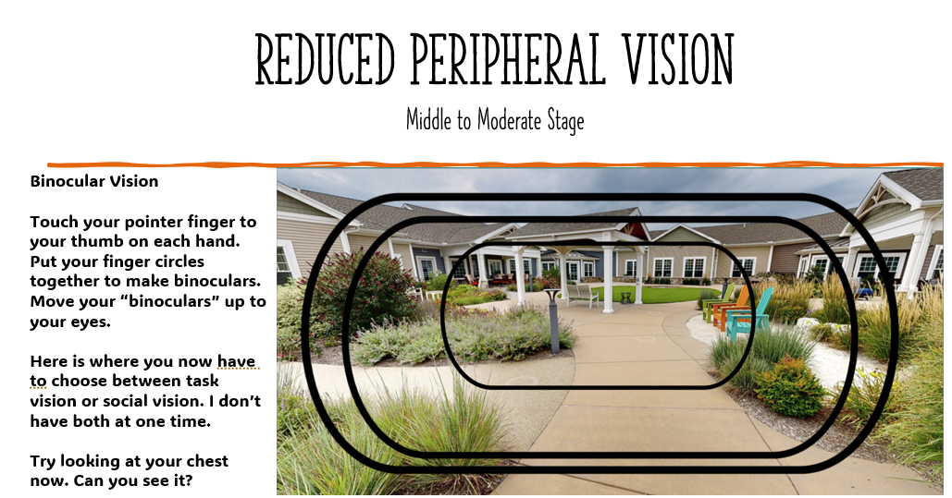
Notes:
As the disease progresses, so might the change in vision field.
This time let’s put our hands in the shape of binoculars.
How much of your vision field did you lose now? How much do you still have?
Look at your chest again? Do you see it? Do you see your buttons?
Demonstrate: Stand close in front of them while they are sitting.
As the disease progresses to this stage, we no longer have social and task vision in one. We now have one or the other. I can see you or I can see what you put in front of me. I can’t see them both at the same time.

Slide 30
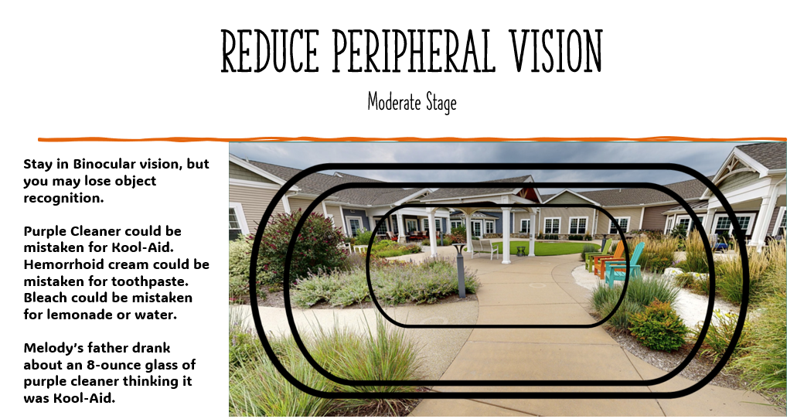
Notes:
This binocular field can remain for quite a long time in comparison.
Let’s use this line of vision as someone possibly in the moderate stage of dementia.
As the disease progresses, the field of vision may stay in binocular, but now we may not be able to recognize the use of an object. Purple Fabuloso (cleaning liquid) may look like Kool-Aid. Bleach may look like milk or lemonade. A tube of hemorrhoid cream may look like toothpaste.

Slide 31
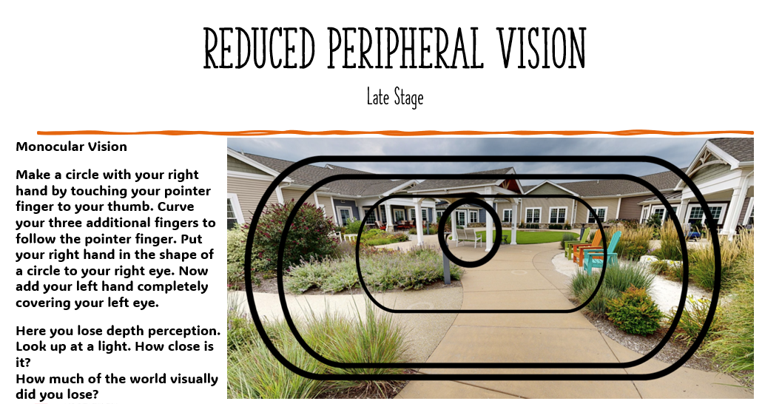
Notes:
These last stages would look like monocular. Close one eye and put your one hand in an opened O shape and put at your opened eye.
How much are you able to see now?
As the disease progresses the O may get smaller and smaller.
Demonstrate: Standing in front of them again as they are sitting. Next back up to 6 feet and squat to eye level. Do not lean in. Put your hand still aside of your face. Which can they see you better. Right in front of them or 6 feet at eye level?
Look up to the light. How close does it look? Have you ever seen someone reaching up and wondering why. In monocular vision, depth perception is lost. Next time, put on your monocular vision and look at what the world possibly looks like for them.

Slide 32


Slide 33
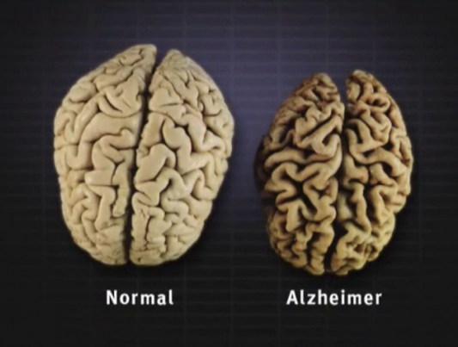
Healthy Brain Vs Brain with Alzheimer’s
https://server5.intermedia.ge/article_images/small/202012/2020122014274587692.png
Notes:
This is a picture of an actual normal healthy brain of a man approximately 74 years of age.
How does the healthy normal brain compare to the brain of a man approximately 74 years of age that was living with Alzheimer's Disease?
Color
Size
Put up 3 fingers
A normal healthy brain weighs about 3+ pounds
The brain is about 60% fat, and about 40% water, protein, carbohydrates and salts.
Take down 1 finger
A person living with dementia can go down to about 2 pounds
That is 1/3 of the brain that is lost

Slide 34
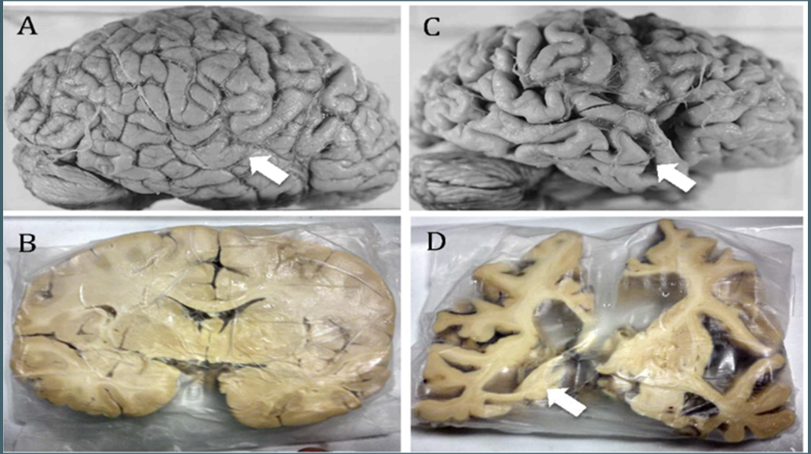
Soto-Rojas, Luis Oskar, et al. “Neuroinflammation and Alteration of the Blood-Brain Barrier in Alzheimer´s Disease.” IntechOpen, IntechOpen, 1 July 2015, www.intechopen.com/chapters/48126.
Notes:
Image A is the healthy brain.
Image C is the person living with Alzheimer’s.
Image B is a slice of the healthy brain. Look at the beautiful white matter and gray matter, which we discussed earlier.
Image D is a slice of the person living with Alzheimer's. What do you see? (Leave time for response.)
Most people see what is missing.
What if we stopped focusing on what they can not do anymore?
What if we stop focusing on their “dementia behaviors”?
What if we looked at what was left?
What if we focused on their abilities instead of their deficits?
Do we want people to focus on things we can’t do?
I can’t _____________ anymore.
What if all you expected of me was something that I can no longer do?
Are your expectations going to be met? How will I feel when I can’t meet those expectations? How might you treat me when I “disappoint” you because I can no longer fulfill your expectations of me?

Slide 35
How does dementia affect the brain
Notes:
Debrief
• Experience
This section we learn how dementia affects the brain, including vision.
• Reflecting
What do you know now that you did not know before we started this section?
Have there been times when you were frustrated with a person living with dementia and you now realize they may have been doing the best they could?
• Thinking
Can you think of an opportunity to show understanding and maybe react differently to something a person living with dementia is or isn’t doing?
• Acting
Think:
Are you willing to be the difference for a person living with dementia?
Are you willing to try again when you fail?
How important is it TO YOU to implement what you are learning?
How important is it FOR THEM for you to implement what you are learning?

Slide 36
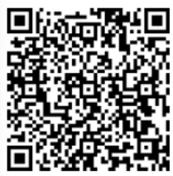
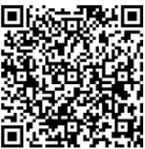
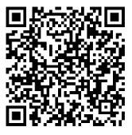
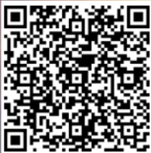
Thank you
For More Information
Melody Karick
CDP, CMDCP, PCHA, PAC
Dementia Consultant, Educator, Certified Cognitive Screener, Creator of C2S Dementia Experience and Education
Please Sign Out
Certificate
Post Survey
Must Complete Sign In, Sign Out, Pre Survey, Post Survey, AND Certificate for Relias Credit
Notes:
Thank You for spending time with me today.
Please remember: New knowledge means NOTHING unless YOU implement it.
You must be committed and practice. You will not master a new skill without practicing.
Please complete QR Codes for signing out, certificate and post survey.

